Slide 1
Newton’s Divided Difference Polynomial Method of Interpolation
Major: All Engineering Majors
Authors: Autar Kaw, Jai Paul
http://numericalmethods.eng.usf.edu
Transforming Numerical Methods Education for STEM Undergraduates
http://numericalmethods.eng.usf.edu

Slide 2
Newton’s Divided Difference Method of Interpolation http://numericalmethods.eng.usf.edu

Slide 3
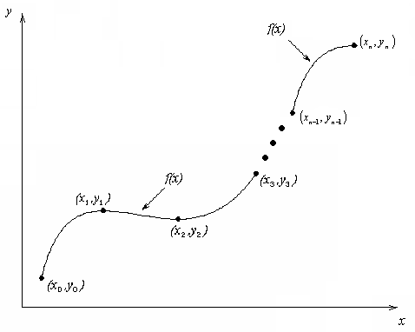
What is Interpolation ?
Given (x₀,y₀), (x₁,y₁), …… (x_{n},y_{n}), find the value of ‘y’ at a value of ‘x’ that is not given.
http://numericalmethods.eng.usf.edu

Slide 4

Interpolants
Polynomials are the most common choice of interpolants because they are easy to:
  Evaluate
  Differentiate, and
  Integrate.
http://numericalmethods.eng.usf.edu

Slide 5



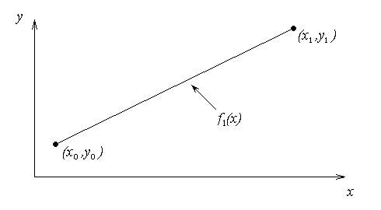

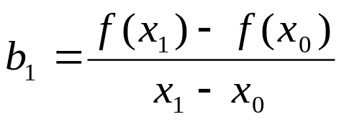
Newton’s Divided Difference Method
Linear interpolation: Given pass a linear interpolant through the data
where
http://numericalmethods.eng.usf.edu

Slide 6
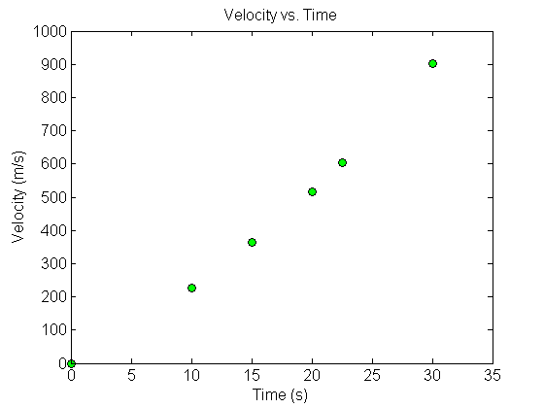



Example
The upward velocity of a rocket is given as a function of time in Table 1. Find the velocity at t=16 seconds using the Newton Divided Difference method for linear interpolation.
Table. Velocity as a
function of time
0 | 0
10 | 227.04
15 | 362.78
20 | 517.35
22.5 | 602.97
30 | 901.67
Figure. Velocity vs. time data
for the rocket example
http://numericalmethods.eng.usf.edu

Slide 7
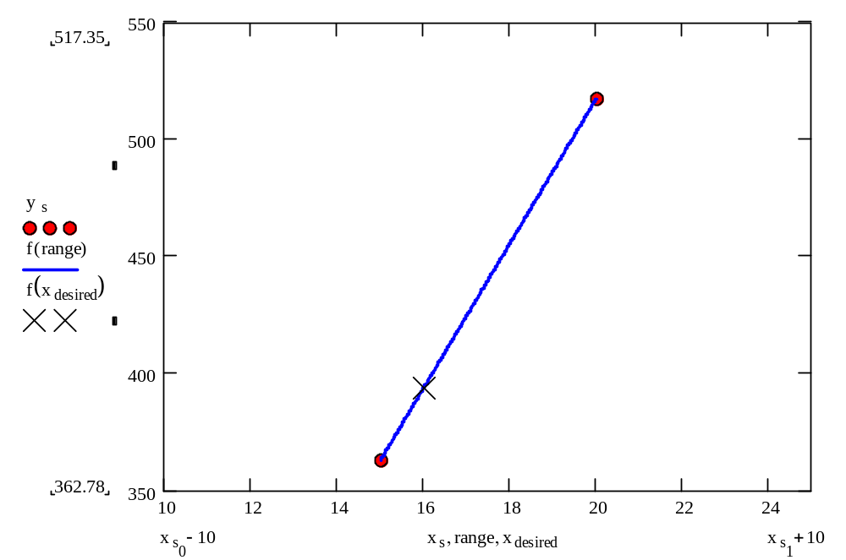
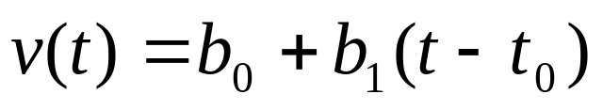
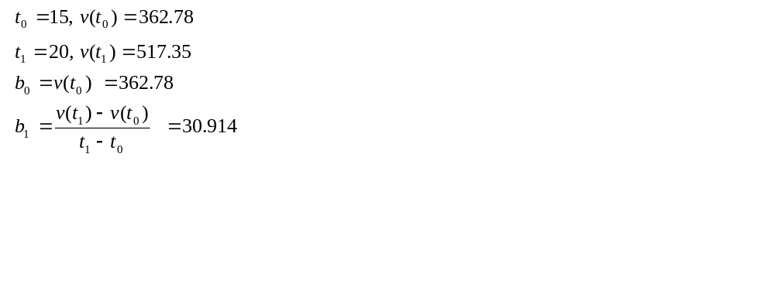
Linear Interpolation
http://numericalmethods.eng.usf.edu

Slide 8
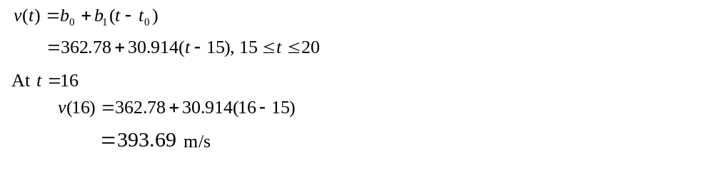
Linear Interpolation (contd)
http://numericalmethods.eng.usf.edu

Slide 9

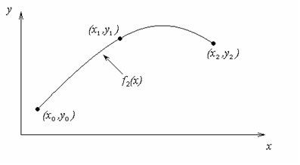
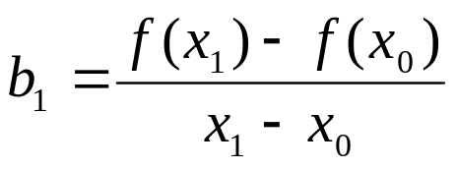
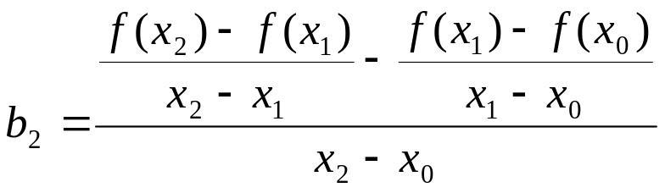
Quadratic Interpolation
http://numericalmethods.eng.usf.edu

Slide 10
Example
The upward velocity of a rocket is given as a function of time in Table 1. Find the velocity at t=16 seconds using the Newton Divided Difference method for quadratic interpolation.
Table. Velocity as a
function of time
0 | 0
10 | 227.04
15 | 362.78
20 | 517.35
22.5 | 602.97
30 | 901.67
Figure. Velocity vs. time data
for the rocket example
http://numericalmethods.eng.usf.edu

Slide 11
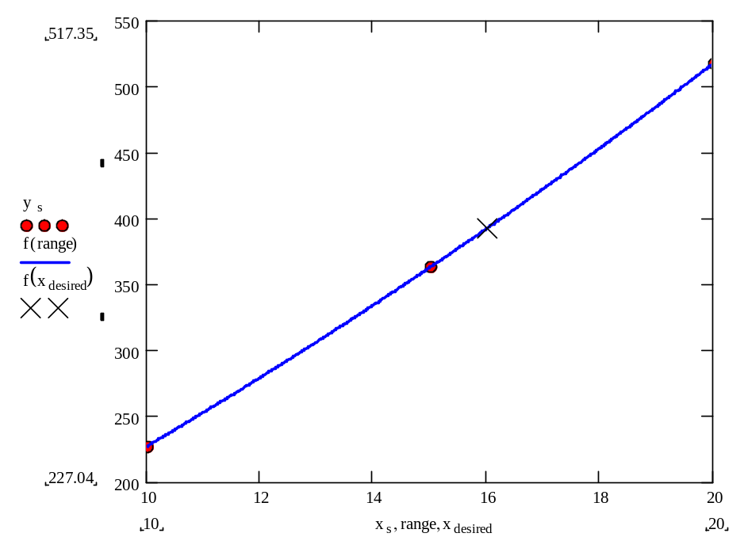
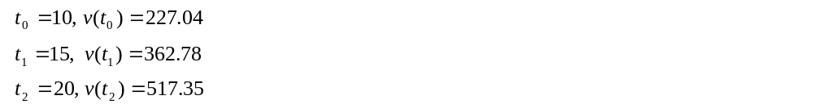
Quadratic Interpolation (contd)
http://numericalmethods.eng.usf.edu

Slide 12
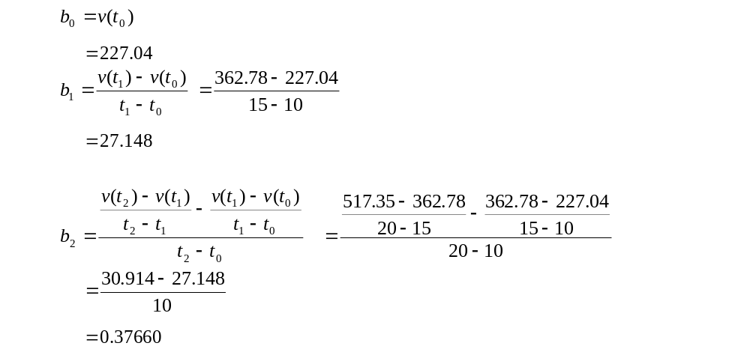
Quadratic Interpolation (contd)
http://numericalmethods.eng.usf.edu

Slide 13
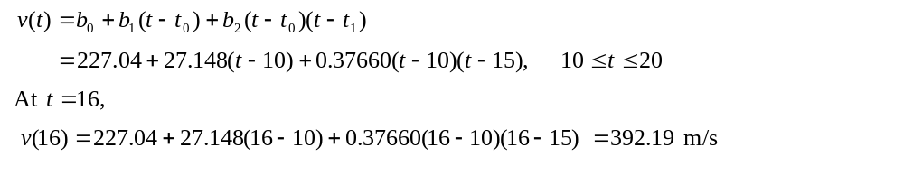
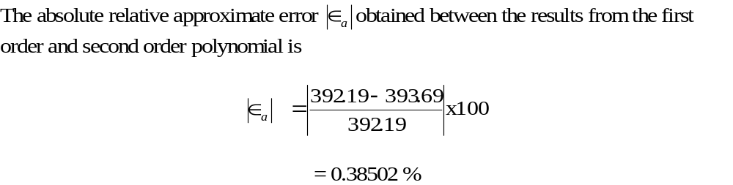
Quadratic Interpolation (contd)
http://numericalmethods.eng.usf.edu

Slide 14
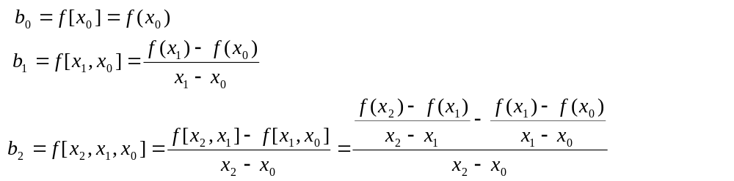
General Form
where
Rewriting
http://numericalmethods.eng.usf.edu

Slide 15
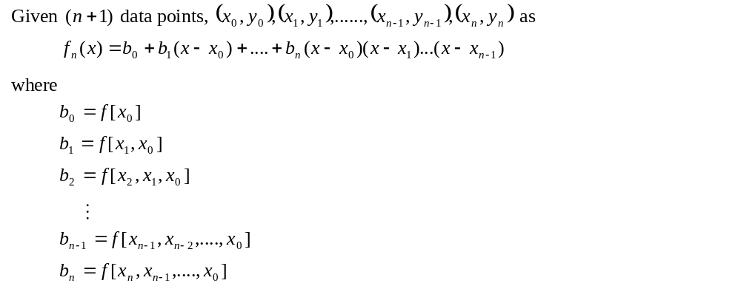
General Form
http://numericalmethods.eng.usf.edu

Slide 16
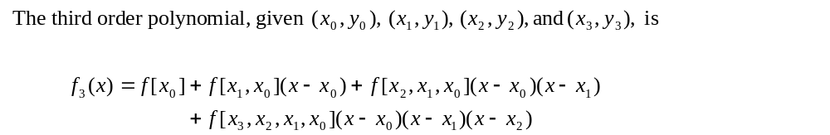
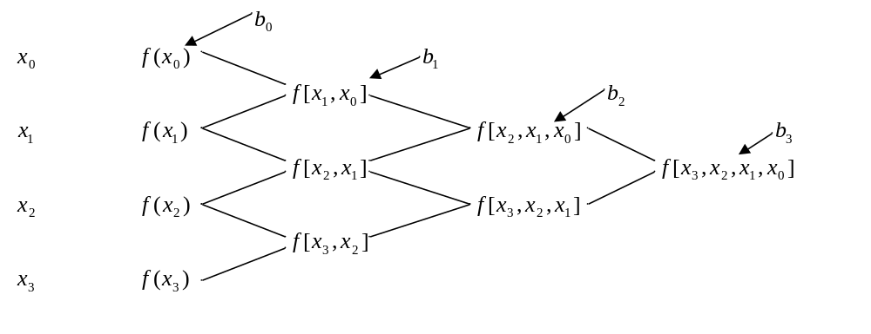
General form
http://numericalmethods.eng.usf.edu

Slide 17
Example
The upward velocity of a rocket is given as a function of time in Table 1. Find the velocity at t=16 seconds using the Newton Divided Difference method for cubic interpolation.
Table. Velocity as a
function of time
0 | 0
10 | 227.04
15 | 362.78
20 | 517.35
22.5 | 602.97
30 | 901.67
Figure. Velocity vs. time data
for the rocket example
http://numericalmethods.eng.usf.edu

Slide 18

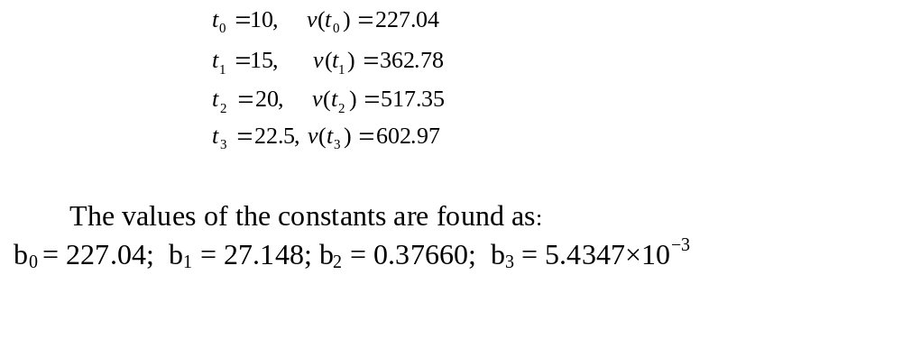
Example
The velocity profile is chosen as
we need to choose four data points that are closest to
http://numericalmethods.eng.usf.edu

Slide 19
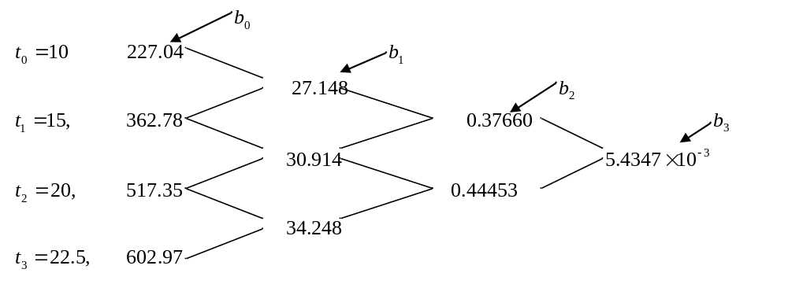
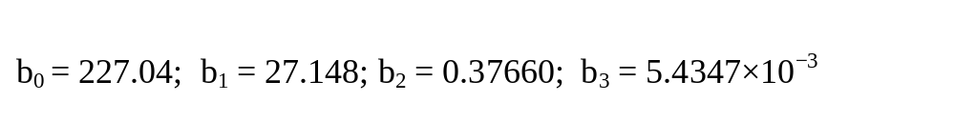
Example
http://numericalmethods.eng.usf.edu

Slide 20
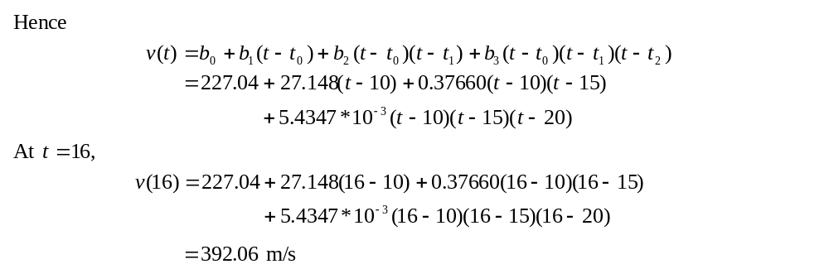

Example
http://numericalmethods.eng.usf.edu

Slide 21
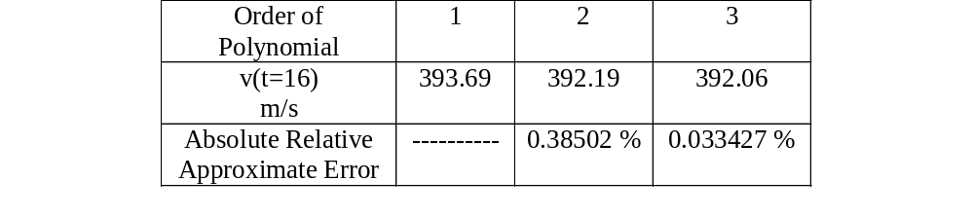
Comparison Table
http://numericalmethods.eng.usf.edu

Slide 22
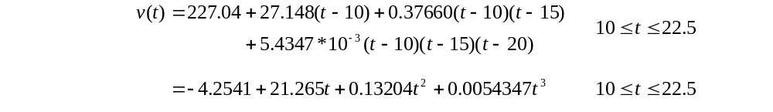
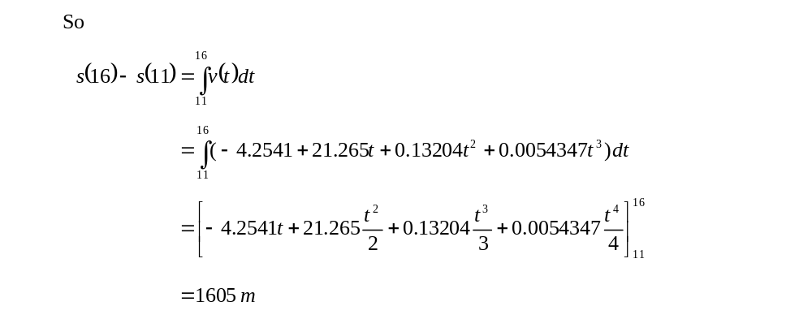
Distance from Velocity Profile
Find the distance covered by the rocket from t=11s to
t=16s ?
http://numericalmethods.eng.usf.edu

Slide 23
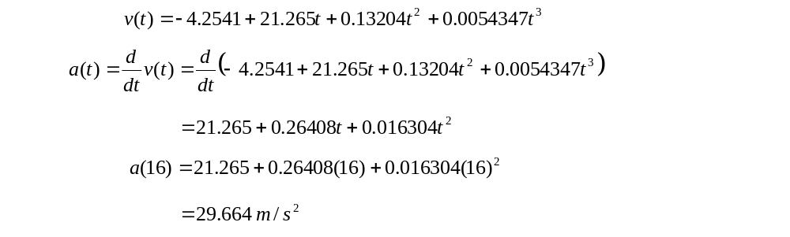
Acceleration from Velocity Profile
Find the acceleration of the rocket at t=16s given that
http://numericalmethods.eng.usf.edu

Slide 24
Additional Resources
For all resources on this topic such as digital audiovisual lectures, primers, textbook chapters, multiple-choice tests, worksheets in MATLAB, MATHEMATICA, MathCad and MAPLE, blogs, related physical problems, please visit
http://numericalmethods.eng.usf.edu/topics/newton_divided_difference_method.html

Slide 25
THE END
http://numericalmethods.eng.usf.edu

